Slide 1
Shale gas impacts on groundwater resources
1
2
Insights from monitoring a fracking site in Poland
Nelly Montcoudiol¹ (Nelly.Montcoudiol@glasgow.ac.uk), Catherine Isherwood², Andrew Gunning², Thomas Kelly², Paul Younger¹
EGU – Vienna – 24th April 2017

Slide 2
Introduction
Shale gas boom in the USA and controversy on environmental impacts of hydraulic fracturing (‘fracking’)
Cautious approach in Europe
SHale gas Exploration and Exploitation induced Risks
Developing best practice to understand, prevent and mitigate the potential short- and long-term environmental impacts and risks from shale gas exploration and exploitation
Three major potential risks:
Induced seismicity
Groundwater contamination
Air pollution

Slide 3
Introduction
Hydraulic fracturing and possible scenarios of impact
d.) Abandoned well legacies – preferential pathways
Impacts on groundwater resources (modified after US EPA (2012))
US EPA (2012). Study of the Potential Impacts of Hydraulic Fracturing on Drinking Water Resources, PROGRESS REPORT, US Environmental Protection Agency Office of Research and Development Washington, DC, December 2012 EPA/601/R-12/011
Notes:
At surface: abandoned well legacies, providing pathways from fracture stimulation zones to near surface GW
Around well-bore as result of failure in well integrity in which drilling fluids or flow back is allowed to escape in surrounding strata
Through GW flow arising from fracture stimulation

Slide 4
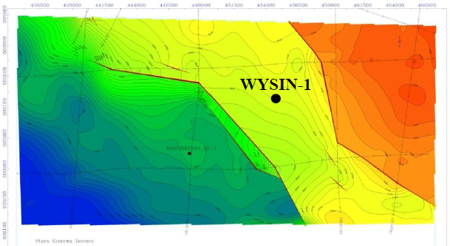
Location of the drilling pad
GW flow
Horizontal wells aligned with fault trends
Source: PGNiG

Slide 5
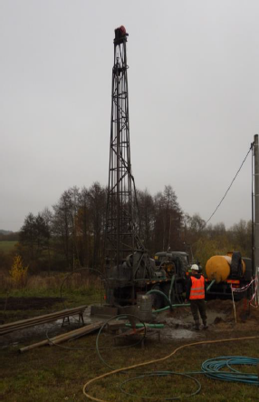
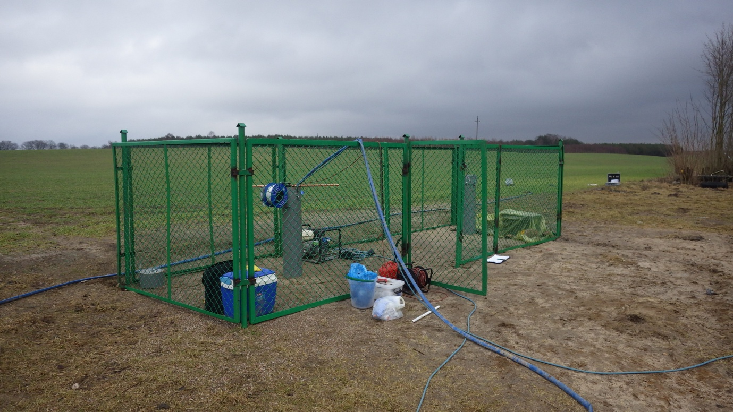
Chronology
Autumn 2015
Drilling of the horizontal wells
Installation of GW monitoring network
Dec. 2015 – May 2016
Baseline monitoring (6 months – 4 site visits)
June – July 2016
Fracking in the 2 horizontal wells
Sampling of GW, frac fluid and flowback fluid
Aug. 2016 - ….
On-going post-frac monitoring (visits every month in 2016, every 2 months in 2017)
2013
Drilling of the vertical well
Notes:
Add pictures

Slide 6
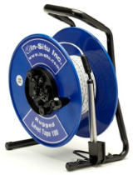
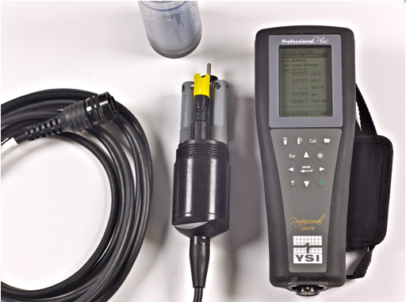
Data collection in the field
Continuous data
Site visits
GW levels
Alkalinity
P_{atm}, T_{air}
Samples for lab
analyses / QA
Ions
Metals
Dissolved gases
Isotopes
Physico-chemical
parameters
Set up for groundwater sampling at well GW3
P_{abs}, T_{GW} & Spec. Cond.

Slide 7
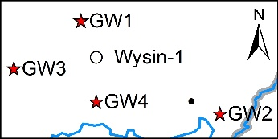
Quaternary geology
Source: C. Isherwood
Notes:
Semi-confined to confined/depth of wells

Slide 8
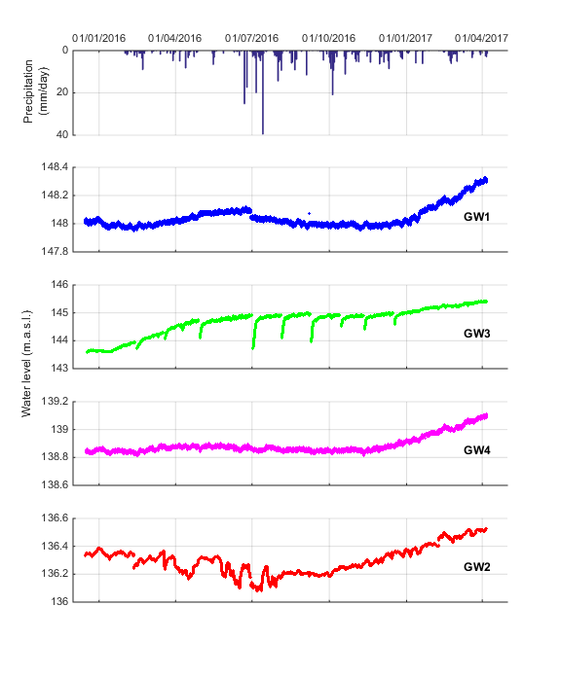
Groundwater levels
Fracking
WYSIN-2
Fracking
WYSIN-3

Slide 9
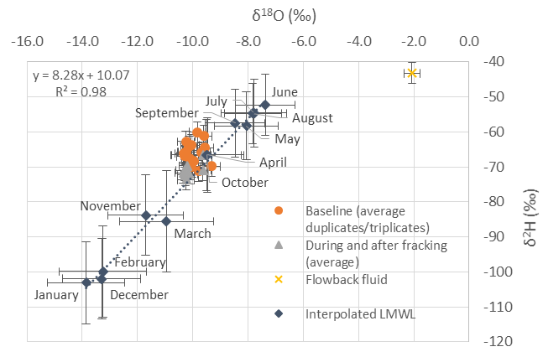
GW stable isotopes & recharge
H₂O stable isotopes
GW samples plot on the GMWL and interpolated LMWL
Recharge in April and/or October
Flowback fluid with different signature
Recharge model
FAO (Allen et al. 1998)
Composite model for soil occupation
25% wheat
25% Ray Grass
20% wood
15% pasture
15% corn
GMWL
(IAEA, 2016)
Dry spring
Wet summer
Wet autumn
Limited
recharge
Some recharge
Recharge
IAEA, 2016. RCWIP (Regionalized Cluster-Based Water Isotope Prediction) Model – gridded precipitation δ¹⁸O|δ²H| δ¹⁸O and δ²H isoscape data. International Atomic Energy Agency. Vienna, Austria. From http://www.iaea.org/water, accessed April 2016.
Allen, R. G., L. S. Pereira, D. Raes & M. Smith, 1998. Crop evapotranspiration - Guidelines for computing crop water requirements-FAO Irrigation and drainage paper 56. FAO, Rome. 300(9): D05109.

Slide 10
Temperature & specific conductivity
Temperature
Specific conductivity
Notes:
Update figures (Matlab)

Slide 11
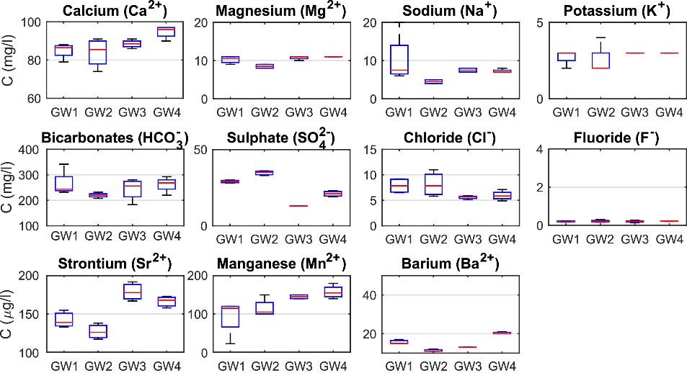
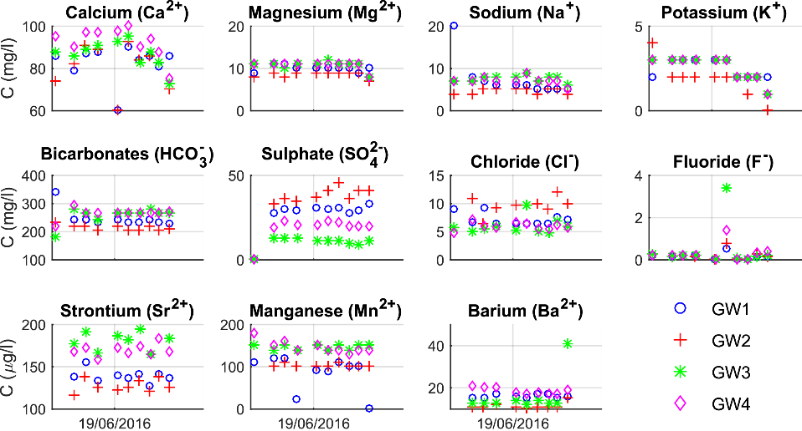
Groundwater chemistry
Groundwater
Ca-HCO₃
Frac fluid
Na-HCO₃?
Flowback fluid
Na-Cl
5
0
5 meq/l
5
0
5 meq/l
1000
0
1000 meq/l
Ca
HCO₃
Mg
SO₄
Na
Cl
Scale 1:200
Temporal variability
During baseline
During entire monitoring

Slide 12
Conclusion & perspectives
Typical Quaternary aquifer
Semi-confined to confined
Limited variations of groundwater levels
Recharge mainly occurring in Autumn
Similar chemistry: Ca-HCO₃ water type, with limited temporal variability
Signature of flowback fluid completely different
No short-term impacts on GW resources from the exploration well / hydraulic fracturing
Statistics: are changes significant?
Groundwater model
Aquifer behaviour
Conditions for detecting impact

Slide 13
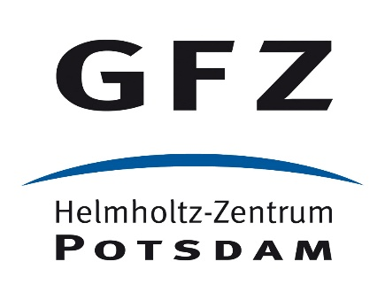
Acknowledgement
This project has received funding from the EU’s Horizon 2020 research and innovation programme under grant number No 640896
www.sheerproject.eu
Project partners
Notes:
Logo of all partners

