Slide 1
Shale gas impacts: real-world monitoring
Groundwater monitoring and assessment in Pomerania, North Poland
N. Montcoudiol (UoG)
The Central Scotland Regional Group of the Geological Society
University of Strathclyde - 21st of September 2016

Slide 2
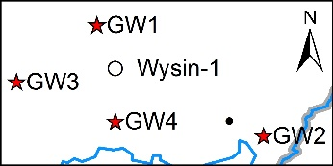
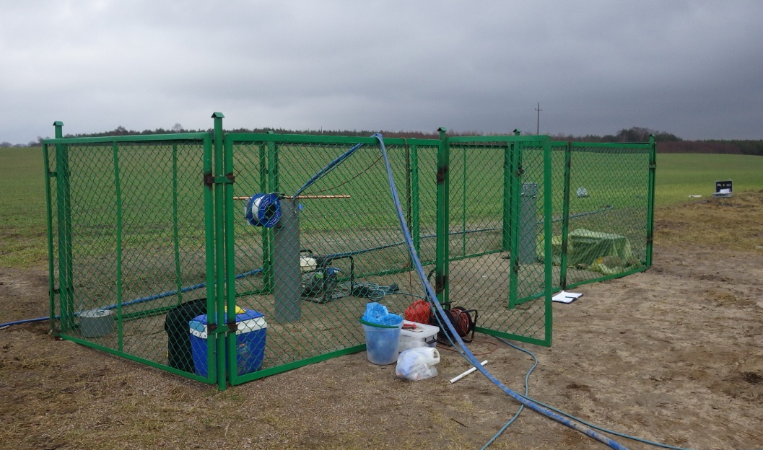
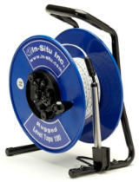
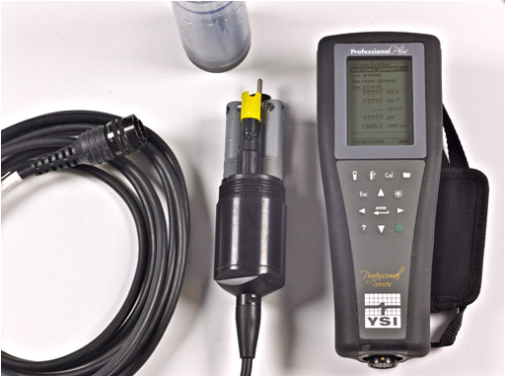
Data collection in the field
Continuous data
P_{atm}, T_{air}, P_{abs}, T_{GW} & Spec. Cond.
Site visits:
GW levels
Physico-chemical parameters
Alkalinity
Samples for lab analyses / QA
Set up for groundwater sampling at well GW3

Slide 3
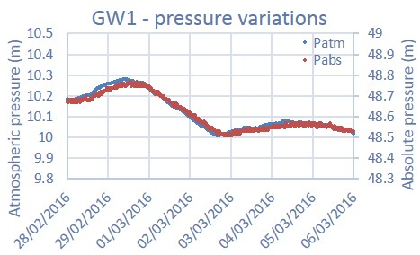
GWL – Total head (raw data)
P_{abs} (head) = P_{w} (WL) + P_{atm}
Δt = 4-9h
GWL increase
Fracking

Slide 4
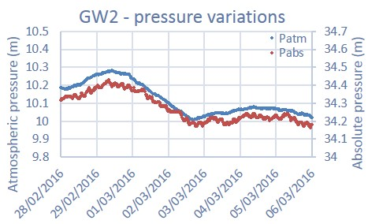
GWL – Total head (raw data)
P_{abs} (head) = P_{w} (WL) + P_{atm}
Δt = 0
GWL decrease
Fracking

Slide 5
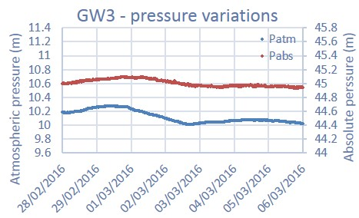
GWL – Total head (raw data)
P_{abs} (head) = P_{w} (WL) + P_{atm}
Δt = 7-22h
GWL increase
Fracking

Slide 6
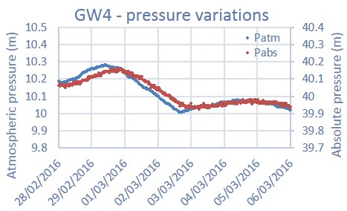
GWL – Total head (raw data)
P_{abs} (head) = P_{w} (WL) + P_{atm}
Δt = 10-14h
GWL constant
Fracking

Slide 7
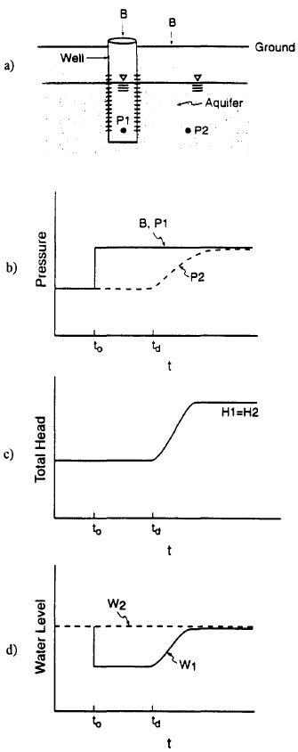
GWL – Barometric correction
Closed wells:
Changes measured in the well reflect changes in the aquifer
Opened wells:
Imbalance between water inside the well and water in the aquifer
↗ P_{atm}
↗ P_{atm}
Confined
Unconfined
Confined
Unconfined
Δt = 4-9h
↘ WL
Δt = 7-22h
Δt = 0
P_{abs} (head) = P_{w} (WL) + P_{atm}
Δt = 10-14h
↗ P_{abs}
↗ P_{abs} with delay
↗ P_{abs}
↗ P_{abs} with delay
Reference: Rasmussen, T. C. & L. A. Crawford, 1997. Identifying and removing barometric pressure effects in confined and unconfined aquifers. Ground Water. 35(3): 502-511. DOI: 10.1111/j.1745-6584.1997.tb00111.x.

Slide 8
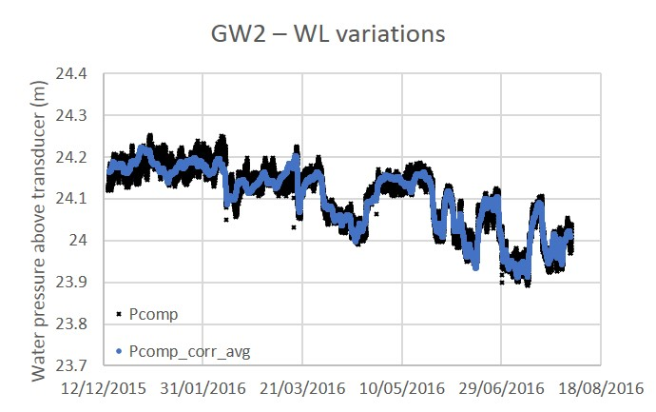
GWL – Barometric correction
Barometric response variable (Δt & ΔP)
Closed well (GW2)
Δt = 0 (no lag)
ΔP_{abs} ≠ ΔP_{atm}
Barometric efficiency α ≠ 1
Barometric efficiency
$α=−\frac{ΔWL}{ΔP_{atm}}≡α=1−$ $\frac{ΔP_{abs}}{ΔP_{atm}}$
α = 1 ⬄ rigid aquifer
α = 0 ⬄ elastic aquifer
Correction methods: Gonthier (2007)
α = 0.16
P_{w/corr} (WL) = P_{abs} – P_{atm} – α (P_{atm/avg} – P_{atm})
Reference: Gonthier, G. J., 2007. A graphical method for estimation of barometric efficiency from continuous data-concepts and application to a site in the Piedmont, Air Force Plant 6, Marietta, Georgia. Scientific Investigation Report 2007-5111. U.S. Geological Survey. Reston, Virginia, USA. 29 p. URL: http://pubs.usgs.gov/sir/2007/5111/pdf/sir2007-5111.pdf.

Slide 9
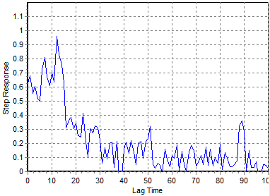
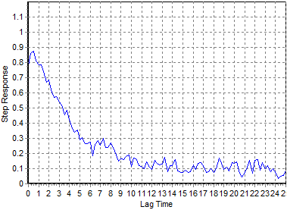
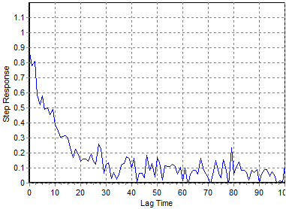
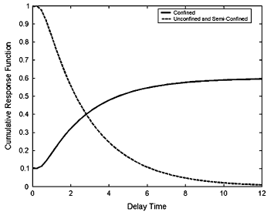
GWL – Barometric correction
Opened wells (GW1, GW3 & GW4)
Δt = ? (variable)
ΔP_{abs} ≠ ΔP_{atm}
Barometric efficiency α ≠ 1
Barometric efficiency as a function of time (Rasmussen & Crawford, 1997)
Correction method: regression deconvolution
Software BETCO (Toll & Rasmussen, 2007)
Define time lag
Δt = 4-9h
Δt = 7-22h
Δt = 10-14h
Well ID | GW1 | GW3 | GW4
Δt | 12h | 40-70h | 24-40h
Confined with well bore storage
Well water level response (opened wells)
Example of step response for GW4
Example of step response for GW1
Example of step response for GW3
References:
Rasmussen, T. C. & L. A. Crawford, 1997. Identifying and removing barometric pressure effects in confined and unconfined aquifers. Ground Water. 35(3): 502-511. DOI: 10.1111/j.1745-6584.1997.tb00111.x.
Toll, N. J. & T. C. Rasmussen, 2007. Removal of barometric pressure effects and earth tides from observed water levels. Ground Water. 45(1): 101-105. DOI: 10.1111/j.1745-6584.2006.00254.x.
Notes:
Add formula

Slide 10
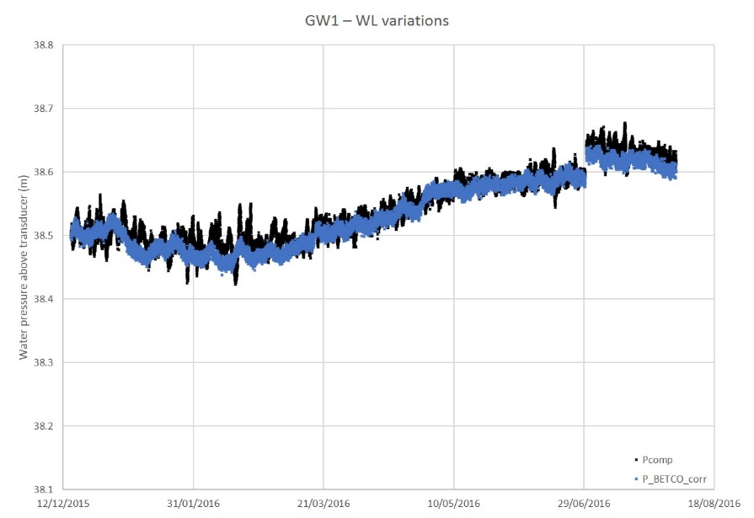
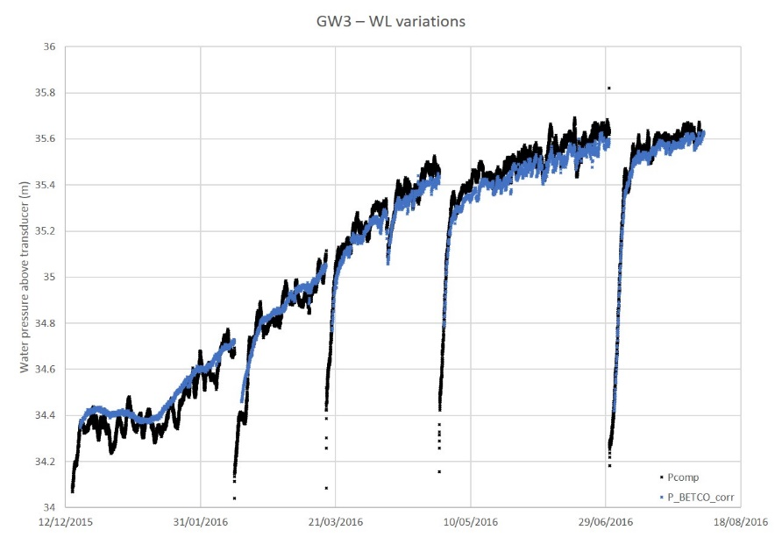
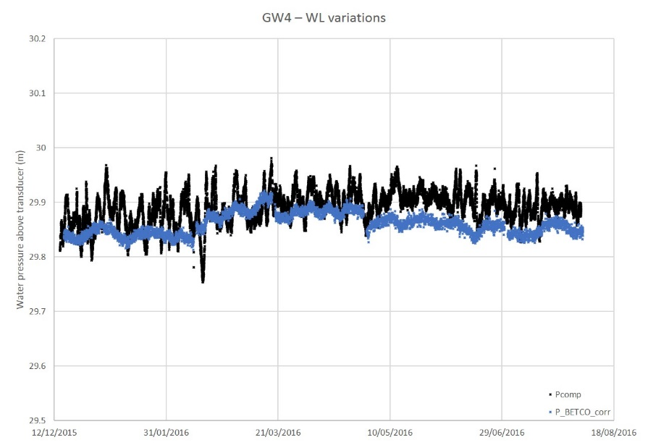
GWL – Corrected levels
GW2: trend towards decrease
GW1: trend towards increase
Fracking
Fracking
GW2 confined confirmed; semi/unconfined behaviour for GW1, GW3 & GW4
GW3: increase + 1.2 m
GW4: stable
Δt = 6d
Δt = 8d
Δt = 8d
Δt = 10d
Fracking
Fracking
Notes:
Add something about the delay

Slide 11
GW chemistry – T°C
Accuracy ± 0.1°C
GW2: sampling brings warmer water / slight increase
GW4: slight increase (like GW1)
GW3: slight decrease / small oscillations
GW1: sampling brings colder water / slight increase
Fracking
Notes:
GW1: increase back quickly (a few hours) and then go down for 5-6d
GW2: 12h to go down

Slide 12
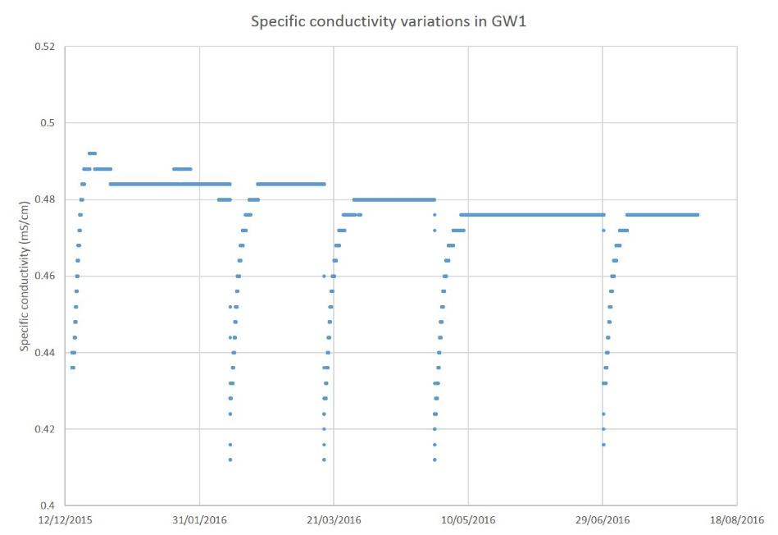
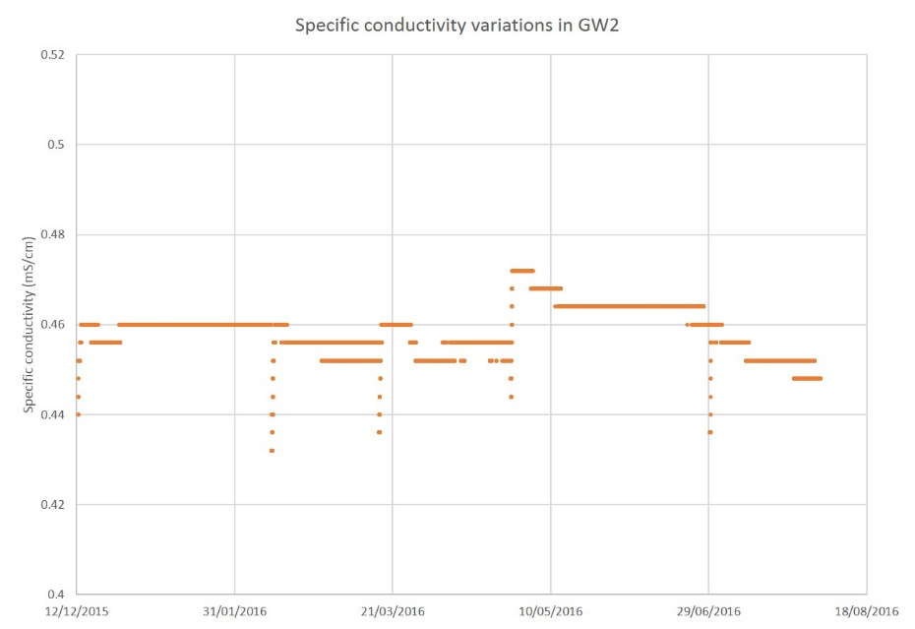
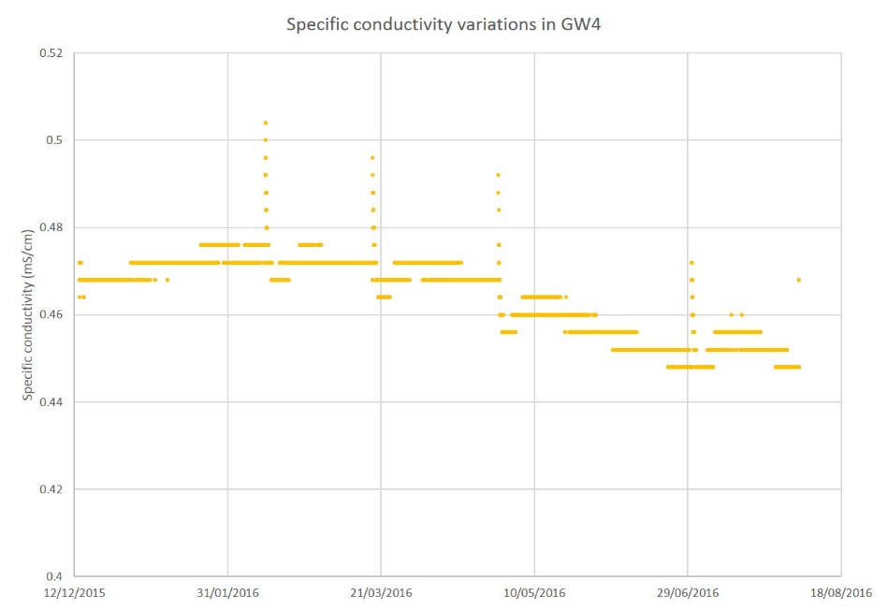
GW chemistry – Specific conductivity
Accuracy ± 1%
↔ 0.005 mS/cm
GW1: decrease during sampling
Recovery: 9-10d
GW2: decrease
during sampling
Quick recovery
Fracking
Fracking
GW3: almost no changes
GW4: increase during sampling
Quick recovery
Fracking
Fracking
Notes:
Check K
GW1: 9d/10d/10d/9d
GW2: quick
GW4: quick

Slide 13
GW chemistry – Analysis results
Quality control: electronic balance / duplicates / blanks
Major ions: Ca-HCO₃ water type
 | GW1 | GW2 | GW3 | GW4
Ca | 87±5 83±11 | 84±7.7 84±11 | 89±2.1 90±3 | 95±3.3 96±3.4
Mg | 10±0.9 10±0.8 | 8.5±0.6 8.8±0.5 | 11±0.5 11±0.6 | 11±0.0 11±0.0
Na | 9.6±5.9 8.6±5.1 | 4.5±0.6 4.8±0.5 | 7.5±0.6 7.8±0.8 | 7.3±0.5 7.5±0.8
K | 2.8±0.4 2.9±0.4 | 2.5±1.0 2.3±0.7 | 3±0.0 3±0.0 | 3±0.0 3±0.0
Alk. | 214±37 209±32 | 180±8 179±18 | 200±36 207±29 | 215±25 217±20
SO₄ | 29±1.0 30±1.0 | 35±1.5 37±2.9 | 13±0.0 12±1.1 | 21±2 21±1.7
Cl | 7.6±1.4 7.3±1.3 | 8.1±2.4 8.9±1.8 | 5.6±0.3 6.2±1.8 | 5.9±0.9 6.1±0.8
Concentrations in mg/l ± 1σ – Alkalinity in mg/l CaCO₃
1st figure for baseline – 2nd figure includes post-frac samples
Notes:
Calcium a bit variable in GW1&GW2
Mg/K/SO4/Cl stable
Na stable except for GW1

Slide 14
GW chemistry – Analysis results
Minor elements
Mn: 100-150 µg/l (2-3x regulations)
Traces: As, Ba, Cr, F⁻, Ni & Sr (< regulations)
< DL: Al, B, Br⁻, Cd, Cu, Fe, Hg, Li, Pb, Sb & Se
Dissolved gases: CH₄, C₂H₆, C₃H₈ and ethylene < DL
Isotopes (analyses on-going)
Water isotopes: δ¹⁸O and δ²H
Sulphate isotopes: δ³⁴S
Carbon isotopes: δ¹³C

Slide 15
GW chemistry – Analysis results
Frac fluid chemistry
Rich in Na and Cl compared to GW (20x)
Poor in Ca and Mg
Flowback fluid chemistry: Na-Cl type resulting from mixing with brines
Very rich in Na (5000x) and Cl (10000x)
Rich in Ca (50x) and Mg (10x)
Poor in HCO₃ and SO₄
Rich in metals: Ba, Br, Mn and Sr ⇨ focus of post-frac monitoring

Slide 16
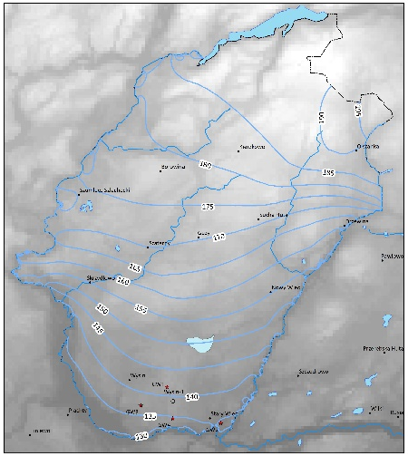
Conclusions
Although drilling logs suggested a rather confined aquifer:
Data from pressure transducers ⇨ GW2 in confined conditions, elsewhere semi-confined or unconfined aquifer
Heterogeneous Quaternary sediments / discontinuous clay layer
Homogeneous chemistry ⇨ same aquifer / limited temporal variability
Downhole probes able to pick up some tiny variations in temperature and specific conductivity following sampling events ⇨ early warning tool for chemical changes
What is next?
Rainfall data
GW modelling (incl. geol. model)
Geostatistics for time-series
Chemical modelling: mixing flowback fluid with GW
Thanks for your attention ☺

Slide 17
Relative variations

Slide 18
Focus on recovery time from sample events

Slide 19
Details on temperature variations on GW3

